Slide 1
Microsoft365 Administration
John Rey Goh

Slide 2

What is Cloud Computing?
Understanding the Basics
Definition: Cloud computing is a model for enabling ubiquitous, convenient, on-demand network access to a shared pool of configurable computing resources (e.g., networks, servers, storage, applications, and services).
Key Characteristics: Cloud computing is characterized by on-demand self-service, broad network access, resource pooling, rapid elasticity or expansion, and measured service.
Deployment Models: The primary deployment models include public cloud, private cloud, hybrid cloud, and community cloud, each offering different levels of security, privacy, and management.
Service Models: Cloud services are typically offered in three main models: Infrastructure as a Service (IaaS), Platform as a Service (PaaS), and Software as a Service (SaaS).
‎
‎Photo by imgix on Unsplash

Slide 3
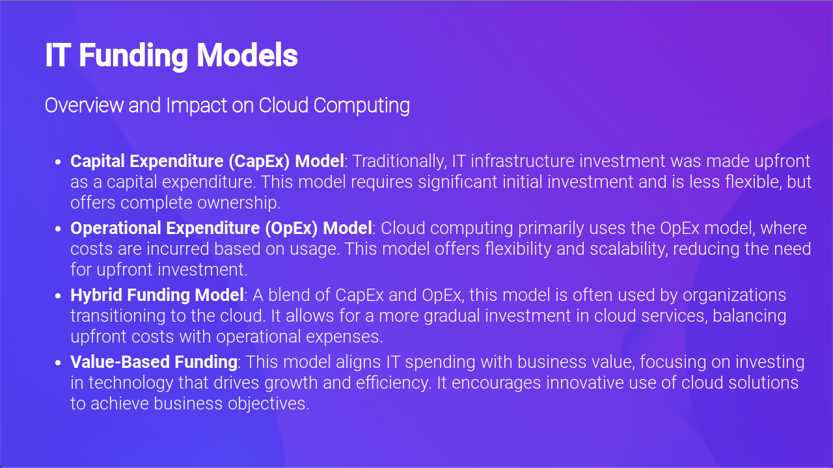

Slide 4

IT Funding Models
Challenges and Solutions
Managing Costs: The shift to cloud computing can lead to unpredictable costs due to the variable expense nature of the OpEx model. Effective cost management strategies are essential.
Security and Compliance: Ensuring data security and regulatory compliance is a challenge under cloud-based models. Adopting robust security measures and compliance practices is crucial.
Legacy Systems Integration: Integrating cloud services with existing legacy systems can be complex and costly. A strategic approach to integration can mitigate these challenges.
Skill Gaps: The transition to cloud computing requires new skills and expertise. Investing in training and development is key to overcoming this challenge.
‎
‎Photo by Thomas Jensen on Unsplash

Slide 5

Privacy in Cloud Computing
Challenges and Strategies
Data Privacy Concerns: Cloud computing poses unique challenges for data privacy, as sensitive information is stored and processed on remote servers owned by third-party providers.
Regulatory Compliance: Organizations must navigate a complex landscape of global data protection regulations, such as GDPR in Europe and CCPA in California, to ensure compliance.
Encryption and Access Control: Employing strong encryption methods for data at rest and in transit, alongside robust access control measures, are critical for protecting privacy.
Vendor Management: Selecting cloud service providers with a strong commitment to privacy and data security, and ensuring clear contractual agreements about data handling and protection responsibilities.
Privacy by Design: Incorporating privacy into the design and architecture of cloud services from the outset, rather than as an afterthought, to enhance overall privacy protection.
‎
‎Photo by Petter Lagson on Unsplash

Slide 6
Pros and Cons of Cloud Computing
Advantages of Cloud Computing
Cost Efficiency: Reduces the need for significant upfront capital expenditure on hardware and software, shifting to a predictable operational expense model.
Scalability and Flexibility: Resources can be scaled up or down based on demand, offering flexibility and avoiding over-provisioning or underutilization.
Business Continuity: Enhances disaster recovery capabilities by storing data off-site in secure, geographically dispersed data centers.
Collaboration Efficiency: Facilitates better collaboration by allowing remote teams to access, share, and work on documents and applications simultaneously.
Access to Advanced Technologies: Enables businesses to access the latest technology and innovation without significant investment or long deployment times.
‎

Slide 7
Pros and Cons of Cloud Computing
Disadvantages of Cloud Computing
Security and Privacy Concerns: Storing sensitive data off-site raises concerns about data breaches, loss, and privacy issues.
Dependence on Internet Connectivity: Cloud services require reliable internet access, making them vulnerable to outages and performance issues.
Limited Control and Flexibility: Customers may have less control over the infrastructure and software customization compared to on-premises solutions.
Data Transfer Costs: Transferring large amounts of data in and out of the cloud can be costly, impacting the overall cost savings.
Compliance and Legal Issues: Navigating the complex landscape of data protection regulations and ensuring compliance can be challenging.
‎

Slide 8
Pros and Cons of Cloud Computing
Conclusion
Balanced Approach: It's crucial for organizations to weigh the benefits against the drawbacks when considering a move to the cloud.
Strategic Decision Making: Decisions should be based on specific business needs, potential for growth, and the ability to manage risks associated with cloud computing.
Future Outlook: As cloud technologies continue to evolve, businesses will find new ways to mitigate the disadvantages while maximizing the benefits.

Slide 9
Popular Microsoft Cloud Services
Azure Compute Services:
Virtual Machines (VMs): Scalable on-demand virtual machines for a wide range of computing solutions.
Azure Kubernetes Service (AKS): A managed container orchestration service for automating deployment, scaling, and operations of application containers.
App Services: A platform for building, deploying, and scaling web apps and APIs quickly and efficiently.

Slide 10
Activity:
Explore MS Azure Compute Services

Slide 11
Popular Microsoft Cloud Services
Azure Storage Services:
Blob Storage: Optimized for storing massive amounts of unstructured data, such as text or binary data.
File Storage: Offers fully managed file shares in the cloud accessible via the SMB protocol.
Queue Storage: A messaging store for reliable messaging between application components.

Slide 12
Activity:
Explore MS Azure Storage Services

Slide 13
Popular Microsoft Cloud Services
Azure Databases:
Azure SQL Database: A fully managed relational database with auto-scale, integral intelligence, and robust security.
Cosmos DB: A globally distributed, multi-model database service for any scale.

Slide 14
Activity:
Explore MS Azure Databases

Slide 15
Popular Microsoft Cloud Services
Azure AI and Machine Learning:
Azure Machine Learning Service: A cloud service for training, deploying, automated ML, and managing machine learning models.
Cognitive Services: A collection of APIs that allow systems to see, hear, speak, understand, and interpret human needs using natural methods of communication.

Slide 16
Popular Microsoft Cloud Services
Azure IoT (Internet of Things):
IoT Hub: A managed service that acts as a central message hub for bi-directional communication between IoT applications and the devices it manages.
IoT Central: A fully managed global IoT SaaS solution that makes it easy to connect, monitor, and manage IoT assets at scale.

Slide 17
Popular Microsoft Cloud Services
Dynamics 365:
A set of intelligent business applications that helps you run your entire business and deliver greater results through predictive, AI-driven insights.
Azure Networking:
Services such as Virtual Network, Load Balancer, VPN Gateway, and Application Gateway to enhance and secure network connectivity in Azure.
Security and Identity Services:
Including Azure Active Directory for identity services, Azure Sentinel for security information event management, and Azure Security Center for unified security management.

Slide 18
Popular Microsoft Cloud Services
Microsoft 365:
A suite of cloud-based productivity and collaboration applications that integrates all Microsoft's existing online applications (Word, Excel, PowerPoint, OneNote, Outlook, Publisher, Sway, and Access) into a cloud service, adding Skype for Business and Microsoft Teams as the main communication and collaboration applications.
See M365 History Timeline:
https://www.microsoft.com/en-us/microsoft-365-life-hacks/stories/looking-back-ten-years-microsoft-365

Slide 19
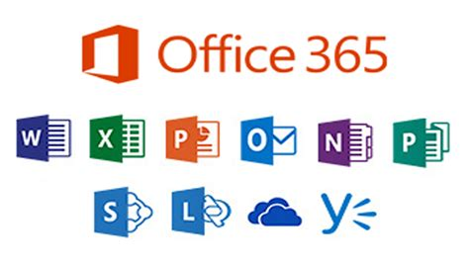
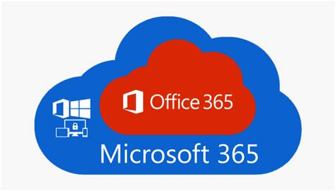
Microsoft365 vs Office365
Key Differences:
Scope: Microsoft 365 is more expansive, offering additional security and device management features on top of the productivity tools found in Office 365.
Target Audience: Office 365 caters more to the general needs of individuals and businesses focusing on productivity tools, while Microsoft 365 is aimed at businesses requiring integrated solutions with advanced security and management.
Pricing: Microsoft 365 plans are generally more expensive than Office 365 plans due to the inclusion of additional features like Windows 10 Enterprise and EMS (Enterprise Mobility + Security).

Slide 20
Microsoft365 Plans and Pricing: https://www.microsoft.com/en-us/microsoft-365/business/compare-all-microsoft-365-business-products
Compare Enterprise Plans: https://www.microsoft.com/en-us/microsoft-365/enterprise/microsoft365-plans-and-pricing
See full enterprise plans comparison table: https://go.microsoft.com/fwlink/?linkid=2139145&clcid=0x409&culture=en-us&country=us

Slide 21
Layers of Microsoft 365
Microsoft 365 Portals:
Signup Experience | Tenant Administration | Landing Pages
Microsoft 365 Platform Services:
Commerce & Billing | Identity Platform | Authentication | Internet DNS
Microsoft 365 Services:
MS Teams | Office Apps | Power Platform Apps | Communication Services

Slide 22
Activity:
Navigating through the various Microsoft 365 Portals

Slide 23
Activity:
M365 Admin Center User Management
-Active Users
-Contacts
-Guest Users
-Deleted Users

Slide 24
M365 Groups

Slide 25
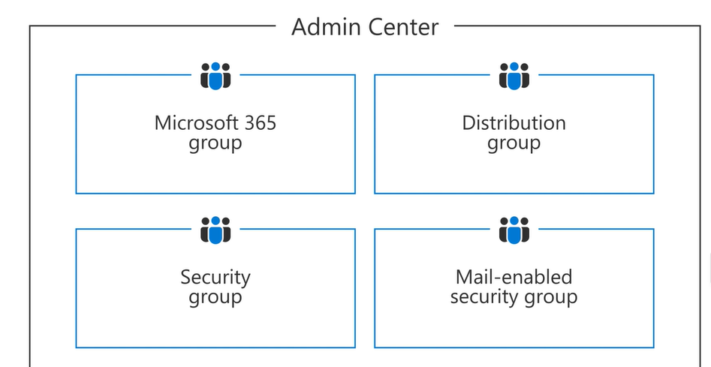

Slide 26
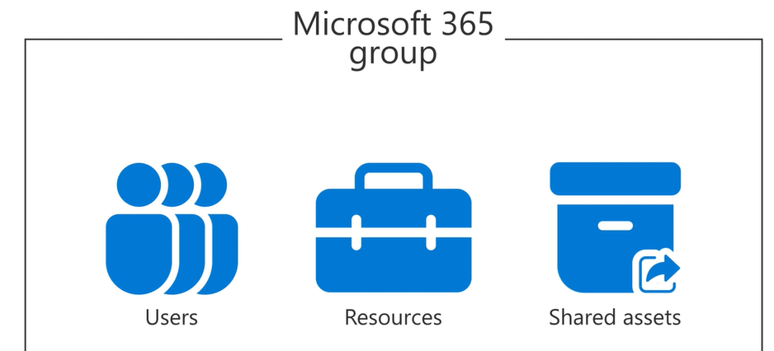

Slide 27
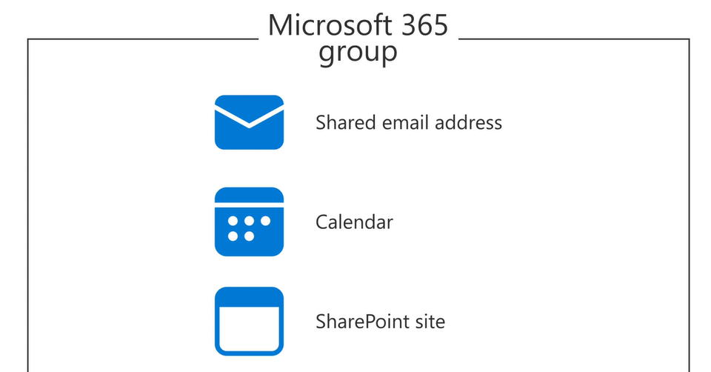

Slide 28
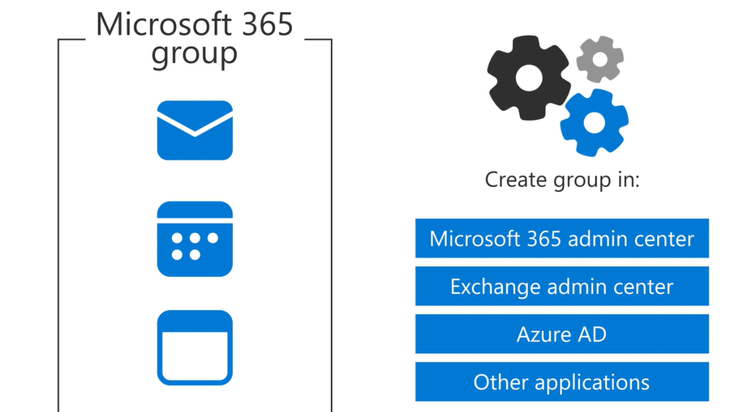

Slide 29
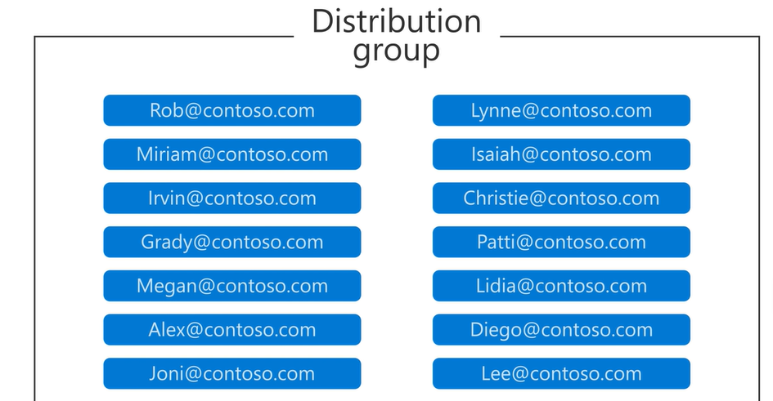
Collection of email addresses

Slide 30
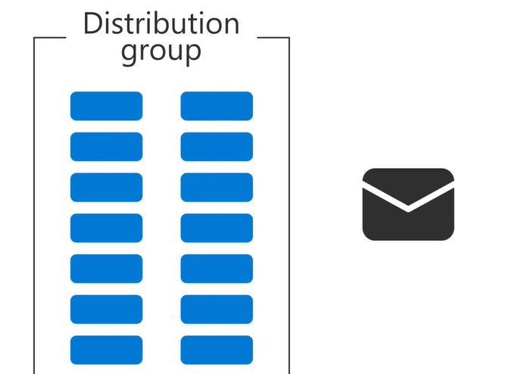
Used to send emails

Slide 31
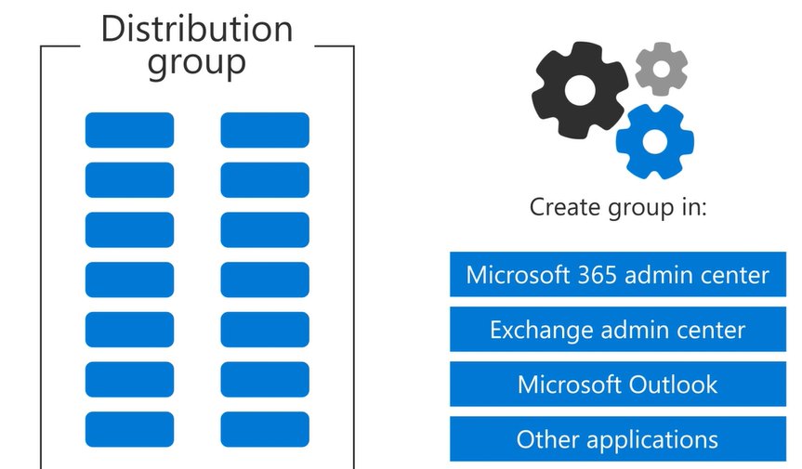

Slide 32
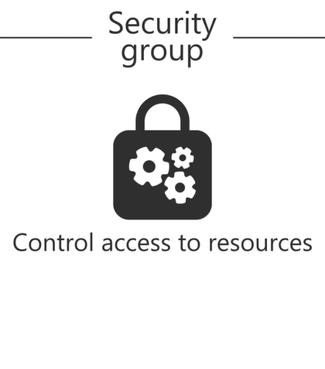
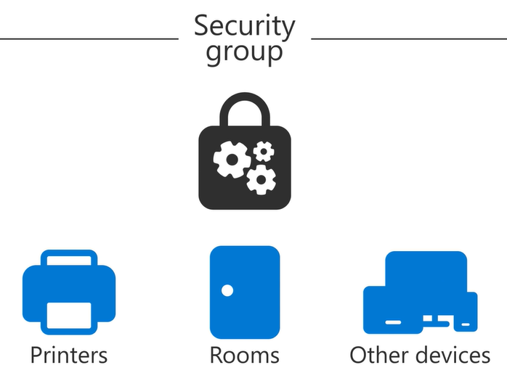

Slide 33
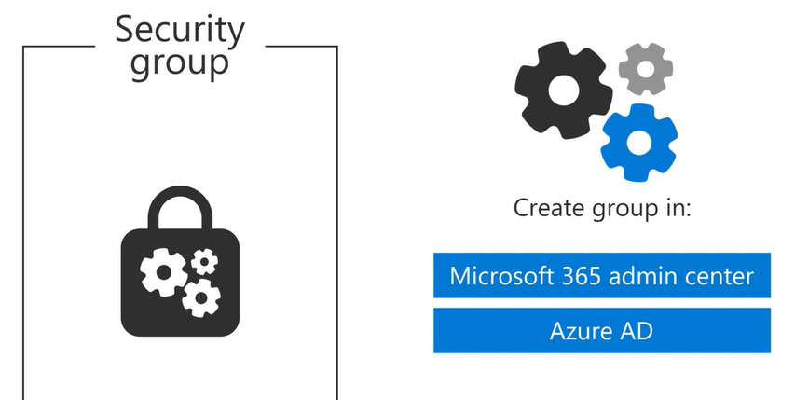

Slide 34
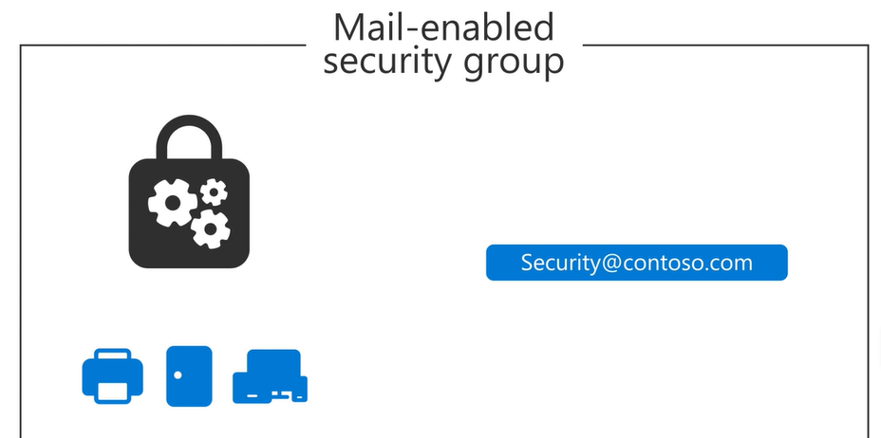
Like a Security Group, but has an email address associated to it

Slide 35
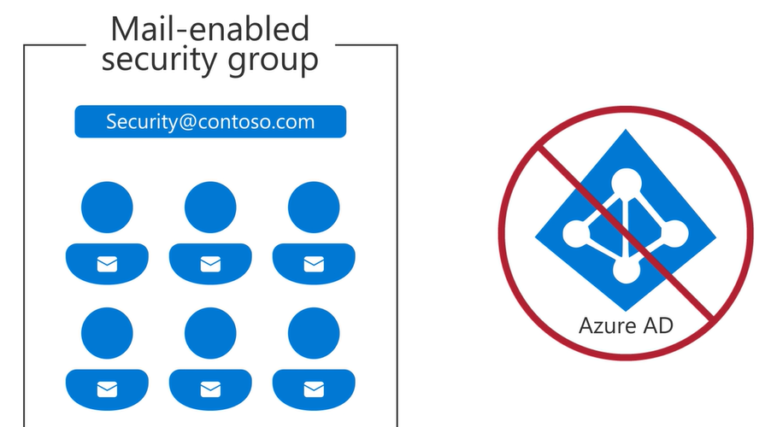

Slide 36
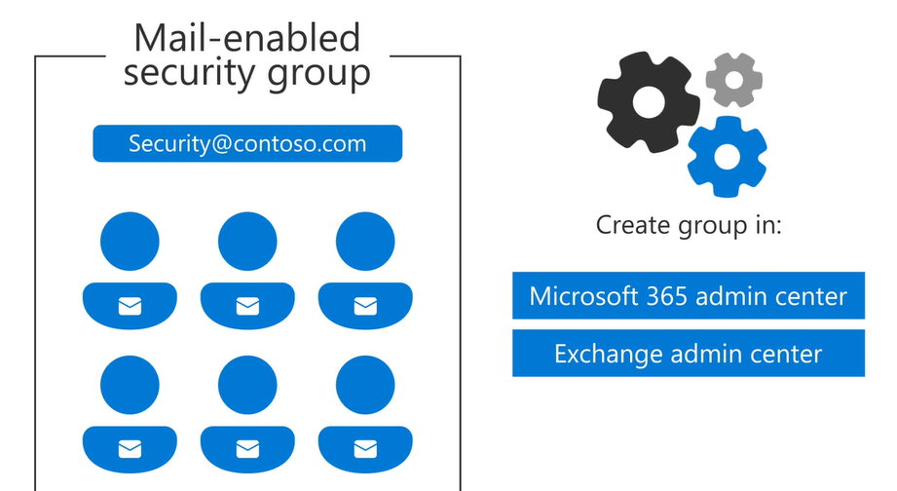

Slide 37
Activity:
M365 Admin Center Teams and Groups
-Active Teams and Groups
-Shared Mailboxes

Slide 38
M365 Role Assignments

Slide 39
Activity:
M365 Admin Center Role Management
-Role Assignments
-Entra ID | Exchange | Billing
-Testing Roles
-Comparing Roles
-Task: Mark as Favorites notable Roles

Slide 40
The most powerful Microsoft 365 admin roles

Slide 41
1. Global Administrator
2. Billing Admin
3. Exchange Administrator
4. SharePoint Admin
5. Site Administrator

Slide 42
Global Administrator responsibilities
This role is automatically assigned to the person who sets up the Microsoft 365 tenant.
With nearly unlimited power, a Global Administrator can manage all aspects of the Microsoft 365 environment, including users, devices, resources, and licenses. This role has the authority to modify settings across all admin centers, create and manage users, assign other admin roles, reset passwords, and manage service requests, to name a few.

Slide 43
Recommendations and alternatives for the Global Admin role
Oftentimes, companies fall into the trap of assigning the Global Administrator role too broadly, even giving it to 100 or more different employees. Given the extensive authority of the Global Administrator role, it is vital to use it judiciously.
Always assign a backup Global Admin to ensure continuous access to critical functionalities in case the primary Global Administrator is unavailable.
Consider assigning a Global Reader role when full Global Administrator powers aren't needed. The Global Reader role can view all settings and reports in the Microsoft 365 admin center but cannot edit any settings. This provides a balance between access and control.

Slide 44
Billing Administrator role
The Billing Administrator plays a crucial role in managing the financial aspects of the Microsoft 365 environment. Recognized as one of the top-tier admin roles by Microsoft Support, the Billing Administrator can open support tickets, make purchases, manage subscriptions and service requests, and monitor service health.
However, despite their financial responsibilities,Billing Administrators cannot fully see payment methods. Specifically, they cannot view anyone’s full credit card information. This limitation is a crucial security measure designed to protect sensitive financial information.

Slide 45
Alternatives for Billing Admins
Assigning the Billing Administrator role should be done carefully due to the financial implications. Consider assigning the Global Reader or a custom role to users instead to limit what a user can manage. This can be done via Azure Active Directory (AD). These roles provide adequate access for managing billing-related tasks without the potential risk associated with full billing admin privileges.

Slide 46
Exchange Administrator
The Exchange Administrator role is pivotal to the smooth functioning of the Microsoft 365 ecosystem. Exchange is the backbone for Microsoft 365, SharePoint, Teams, and more. The Exchange Administrator has the power to access user mailboxes, manage Exchange Online settings, and perform tasks like setting up mail flow rules, managing malware filters, and configuring compliance features.
However, the power to access user mailboxes makes the Exchange Administrator role one that should not be assigned lightly. The potential for misuse of this access is a significant security concern.

Slide 47
Exchange Admin alternative
To mitigate potential security risks, consider assigning Exchange Admins the Service Support Administrator role. This role can see service health and release notifications, providing necessary oversight without the extensive access that comes with the Exchange Administrator role.

Slide 48
SharePoint Admin responsibilities
The SharePoint Administrator manages the SharePoint Online environment within the Microsoft 365 suite. They have access to the SharePoint Online (SPO) Admin center, all content, and the OneDrive Admin Center. Their responsibilities include creating and managing sites, managing site admins, managing sharing settings, managing Microsoft 365 groups, and managing site storage limits.
Global Administrators are also SharePoint Online administrators by default. While SharePoint Administrators can view user information, they cannot modify existing information. Only the Global Administrator has that capability, which is a built-in security measure to limit the potential misuse of admin privileges.

Slide 49
Recommended alternative to the SharePoint Admin role
Given the extensive access of the SharePoint Administrator role, organizations should carefully consider who needs full SharePoint Admin rights. One recommendation is to consider if a Teams Administrator role is sufficient for the user's needs.

Slide 50
Site Administrator role
The Site Administrator, previously known as "Site Collection Owners", primarily manages sites within the Microsoft 365 environment. They have the power to manage permissions and restrict access where necessary, manage content types, site columns and templates for re-use in the sites, and update site structure based on content requirements.
Despite their control over sites, Site Administrators are limited in their access to the broader Microsoft 365 environment. They cannot access the Office 365 Admin portal and, thus, cannot see user information.

Slide 51
Grant least privileged access using the Site Admin role
The Site Administrator role can be a way to limit an admin’s powers. By providing them with the necessary access to manage sites without the broader access that comes with other admin roles, the Site Administrator role is a good example of how to implement the principle of least privilege, which is a key security best practice.

Slide 52
M365 Billing

Slide 53
Activity:
Explore Billing and License Management
-Purchase Services
-Your Products
-Licenses
-Bills and Payments
-Billing Accounts
-Payment Methods
-Billing Notification

Slide 54
M365 Settings

Slide 55
Activity:
-Explore add/buy domain
-Search and Intelligence
-Org Settings
-Integrated Apps
-Microsoft Edge Policies

Slide 56
M365 Setup

Slide 57
Activity:
Guided Setup

Slide 58
M365 Reports

Slide 59
Activity:
Checking Usage Reports

Slide 60
M365 Reports

Slide 61
Activity:
Checking Service Health

Slide 62
Activity:
Checking Message Center for Planned Changes and its Impact

Slide 63
Identity and Access Management

Slide 64
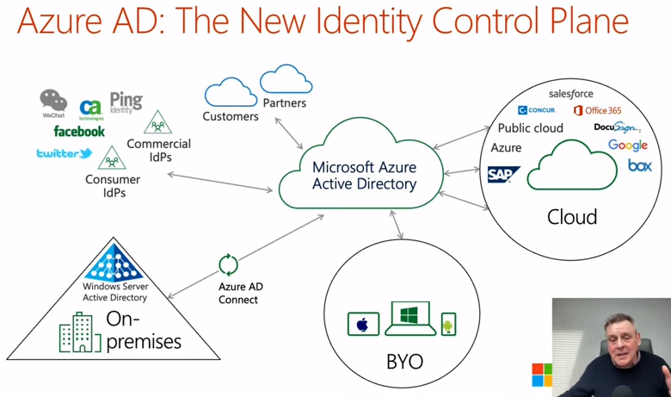

Slide 65
Microsoft Entra and Azure AD
Key Differences and Relationship
Scope and Focus: Azure AD is specifically focused on identity and access management as a service, primarily for cloud-based environments. Microsoft Entra, on the other hand, represents a broader suite of security and access management solutions, including Azure AD as one of its components.
Components: Azure AD is a single, cohesive service, while Microsoft Entra is an umbrella term that includes Azure AD along with other security and identity management solutions like Permissions Management and Verified ID.
Purpose: Azure AD provides foundational identity services necessary for secure access management in the Microsoft ecosystem. Microsoft Entra expands on this by offering additional tools and services aimed at addressing more complex and evolving security challenges, such as managing permissions across multi-cloud environments and providing secure, decentralized identity verification.

Slide 66
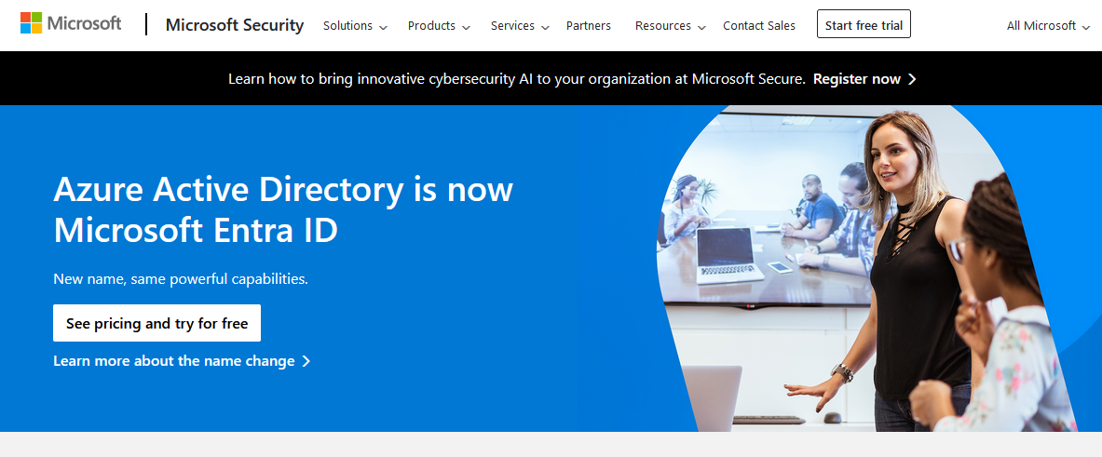
https://www.microsoft.com/en-us/security/business/identity-access/microsoft-entra-id

Slide 67
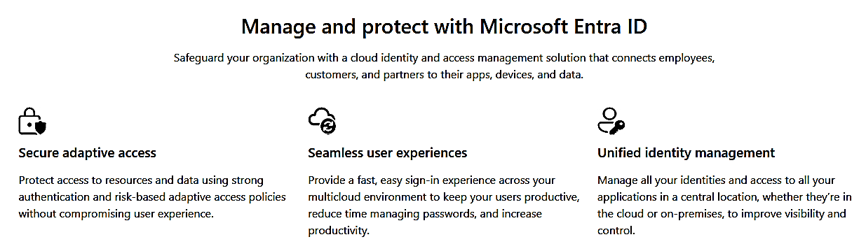
https://www.microsoft.com/en-us/security/business/identity-access/microsoft-entra-id

Slide 68
Activity:
Exploring Microsoft Entra

Slide 69
Exploring and Familiarizing with Microsoft 365 Services

Slide 70
Activity:
Perform activities set by trainer to get familiarized with most Microsoft 365 services:
-Office Apps
-Teams
-Forms
-Planner and Calendar
-Exchange and Outlook
-SharePoint
-Power Platform (Power Apps, Power Automate, Power Pages)
-Power BI
-Engage
-Lists

Slide 71
Activity:
Perform activities set by trainer to get familiarized with most Microsoft 365 Administration Centers and Org Settings for the following:
-Office Apps
-Teams
-Forms
-Planner and Calendar
-Exchange and Outlook
-SharePoint
-Power Platform (Power Apps, Power Automate, Power Pages)
-Power BI
-Engage
-Lists

Slide 72
Identity, Security and Compliance

Slide 73
Activity:
[Identity]
Exploring Microsoft Entra

Slide 74
Compare Microsoft 365 Business and Enterprise

Slide 75
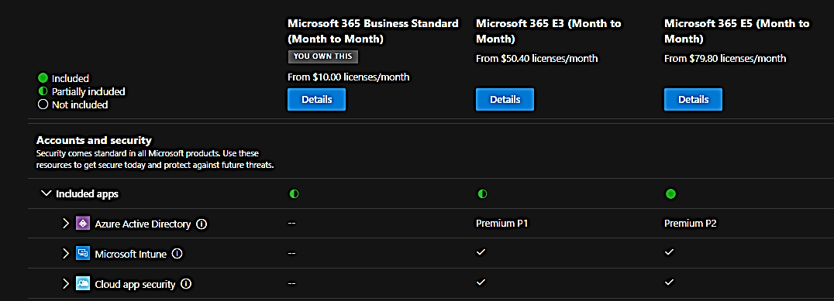

Slide 76
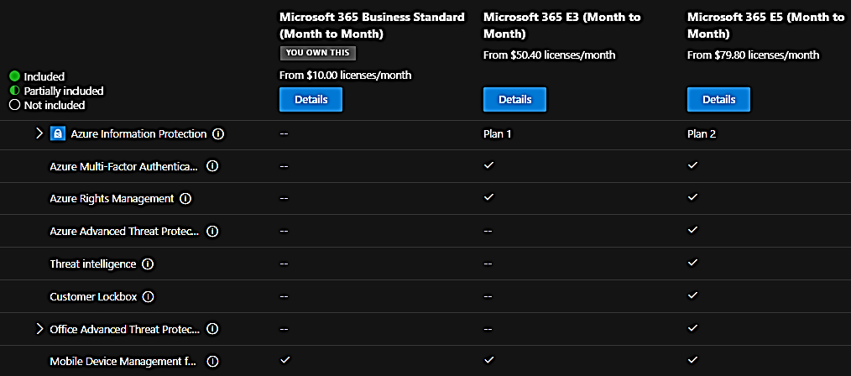

Slide 77
Cloud Connected Device Management

Slide 78
Activity:
[Endpoint Management]
Exploring Microsoft Intune

Slide 79
1. Setting up Azure Active Directory
*can be done in Microsoft Entra
Device Registration: Devices need to be registered or joined to Azure AD to enable identity management. Azure AD Join is used for devices exclusively used for work, while Azure AD Registered is for personal devices accessing work resources.
Conditional Access: Set up Conditional Access policies to ensure that only secure and compliant devices can access your organization's resources.

Slide 80
2. Enrolling Devices into Microsoft Endpoint Manager (Intune)
*Microsoft E3 or E5 License Required for Intune
*can be done in Microsoft Intune https://intune.microsoft.com/
*your admin should have Intune Admin Role and Intune License
Entra -> select user -> azure role assignment
Device Enrollment: Use Microsoft Endpoint Manager to enroll devices. This can be done automatically for Windows devices through Windows Autopilot, or manually for iOS, Android, and other Windows devices not covered by Autopilot.
Profile Configuration: Configure profiles in Intune to specify settings and features on devices, including security policies, VPN configurations, Wi-Fi settings, and more.

Slide 81
3. Managing Device Compliance
*Microsoft E3 or E5 License Required for Intune
*can be done in Microsoft Intune https://intune.microsoft.com/
*your admin should have Intune Admin Role and Intune License
Entra -> select user -> azure role assignment
Compliance Policies: Define compliance policies in Intune to enforce security baselines, such as requiring a PIN or password, encrypting data, and ensuring the latest OS updates are installed.
Conditional Access Integration: Use compliance policies in conjunction with Conditional Access policies to restrict access to corporate resources from non-compliant devices.

Slide 82
4. Deploying and Managing Apps
*Microsoft E3 or E5 License Required for Intune
*can be done in Microsoft Intune https://intune.microsoft.com/
*your admin should have Intune Admin Role and Intune License
Entra -> select user -> azure role assignment
App Deployment: Use Intune to deploy both web and native applications to enrolled devices. You can specify required apps for all devices or make them available for optional installation through the Company Portal app.
App Protection Policies: Protect data within apps by configuring app protection policies, which can enforce data encryption, prevent data from being moved to personal apps, and require additional authentication.

Slide 83
5. Monitoring and Reporting
*Microsoft E3 or E5 License Required for Intune
*can be done in Microsoft Intune https://intune.microsoft.com/
*your admin should have Intune Admin Role and Intune License
Entra -> select user -> azure role assignment
Device and App Monitoring: Use the Microsoft Endpoint Manager admin center to monitor the health, compliance, and usage of enrolled devices and deployed apps.
Audit Logs and Reports: Regularly review audit logs and generate reports to assess compliance, monitor device and app performance, and identify potential security issues.

Slide 84
6. Securing Devices
*Microsoft E3 or E5 License Required for Intune
*can be done in Microsoft Intune https://intune.microsoft.com/
*your admin should have Intune Admin Role and Intune License
Entra -> select user -> azure role assignment
Endpoint Security: Implement endpoint security policies in Intune to protect against threats, including configuring antivirus settings, firewall rules, and attack surface reduction rules.
Data Loss Prevention: Use Microsoft 365 data loss prevention (DLP) policies to protect sensitive information from being accidentally shared.

Slide 85
Security

Slide 86
Activity:
[Security]
Exploring Microsoft Defender

Slide 87
Compliance

Slide 88
Activity:
[Compliance]
Exploring Microsoft Purview

Slide 89
Sensitivity Labels

Slide 90
Using Sensitivity Labels and Azure Information Protection (AIP) in Microsoft 365 involves a series of steps to classify, label, and protect your organization's documents and emails. These features enable you to apply labels manually or automatically based on specific criteria, helping to ensure that sensitive information is handled appropriately.

Slide 91
Step 1: Plan Your Classification and Labeling Strategy
Identify the Types of Information you need to protect, such as personal data, financial information, or confidential projects.
Define Labeling Policies that match your organization's data protection needs.
Consider labels like "Public", "General", "Confidential", and "Highly Confidential".

Slide 92
Step 2: Create Sensitivity Labels
Sign in to Microsoft 365 Compliance Center: Go to https://compliance.microsoft.com and sign in with your admin account.
Navigate to Solutions > Information protection (if you haven’t yet, you’ll need to set up permissions).
Create a Label: Click on “+Create a label” and follow the prompts to define the label’s name, description, and protection settings (encryption, content marking, access restrictions).
Publish the Labels: After creating labels, you need to publish them by creating a label policy. Go to “Publish labels” and select the labels you want to publish. Then, decide which users or groups the policy applies to.

Slide 93
Step 3: Configure Azure Information Protection
If you have Azure Information Protection (AIP) Plan 1 or Plan 2 as part of your subscription, you can integrate it with sensitivity labels.
Install the AIP Unified Labeling Client (if needed) on users’ machines to enable labeling in Office apps.
Use the AIP on the Azure portal to manage additional protection settings and to classify and protect documents and emails manually or automatically.

Slide 94
Step 4: Apply Sensitivity Labels
Manually Apply Labels: Users can manually select the appropriate label for documents and emails based on the content sensitivity.
Automatic and Recommended Labeling: You can configure policies to automatically apply labels based on content detection or recommend a label to users.

Slide 95
Step 5: Monitor and Train
Monitor Label Usage and Compliance: Use the compliance center to monitor how labels are being used and to identify any potential issues or areas where additional user training may be needed.
Educate Your Users: Train your users on the importance of data classification and how to use sensitivity labels correctly.

